Slide 1
[Upon Arrival in Korea] 14 days quarantine
※ 상세 연락처 추가ver.

Slide 2
[서울 Seoul 캠퍼스]
어학연수생 담당자 연락처
Phone number : 010-5216-1513
KAKAOTALK ID : mju1513
WECHAT ID : myongji_university
ZALO ID : +82) 01052161513
※ 입국 전, 각 캠퍼스 메신저 아이디를 추가하세요.
Before the entry, install the app (Kakaotalk)
and add ID for each campus.
入境前，请务必添加各校区的微信。
Trước khi nhập cảnh, vui lòng kết bạn
với nhà trường qua tài khoản ZALO
tương ứng với cơ sở mình theo học.
Оруулахын өмнө програмыг суулгана уу (Kakaotalk) оюутны хотхон бүрт ID нэмж оруулаарай.
[서울 Seoul 캠퍼스]
어학연수생 담당자 연락처
Phone number : 010-5216-1513
KAKAOTALK ID : mju1513
WECHAT ID : myongji_university
[용인 Yongin 캠퍼스]
어학연수생 담당자 연락처
Phone number : 010-8071-1513
KAKAOTALK ID : yonginmyongji_univ
WECHAT ID : yongin_mju
ZALO ID : +82) 01080711513

Slide 3
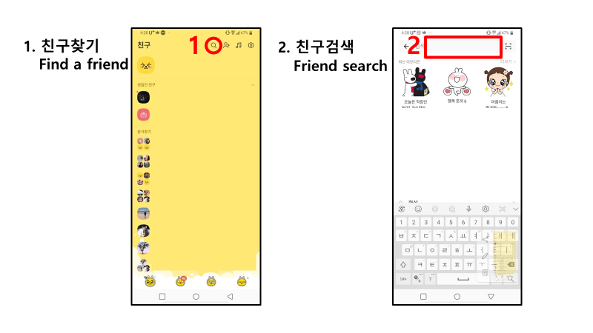
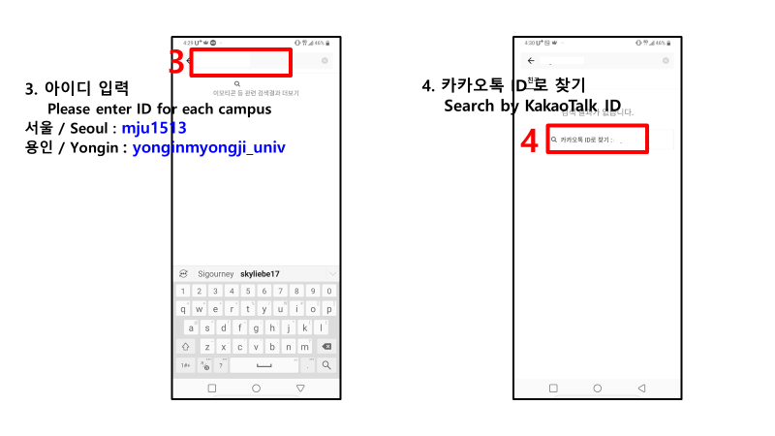
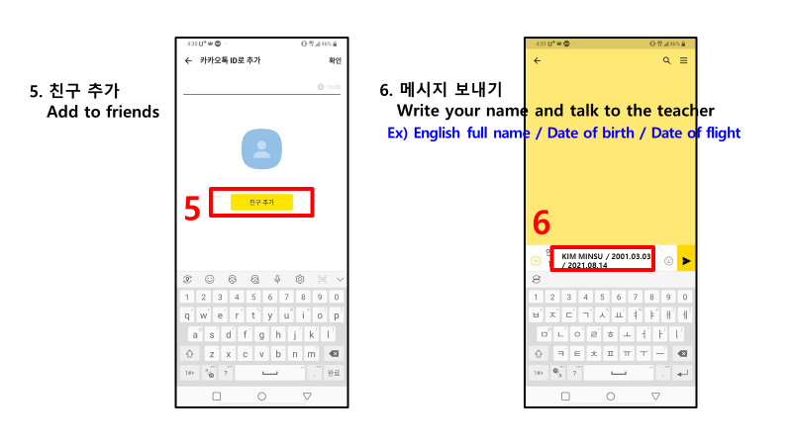
1. 메신저 아이디 추가 (kakaotalk/wechat/zalo) 2. 메시지 보내기 (영문명 / 생년월일 / 입국날짜) Step1. Add the kakaotalk ID for each campus Step2. Send a message
(Name in English/Date of birth/Arrival Date) 第一. 添加各小区的微信 第二. 发送信息（护照上英文名、出生日期、航班日期）
Bước 1: Kết bạn ZALO với trường (theo đúng ID tài khoản tương ứng với cơ sở mình học)
Bước 2: Nhắn tin cho trường với nội dung Tên tiếng Anh/Ngày tháng năm sinh/ Ngày nhập cảnh)

Slide 4
Procedure
Home country : 1st PCR Test
※ PCR test result issued at most 72 hours before
departure from the first embarkation point
Arrival in Korea
(Incheon airport)
local health center:
2nd PCR Test
①
②
③
⑥
⑤
④
End of quarantine
period
local health center:
3rd PCR Test
※on the 13th~14th day (1~2 days before the last day of the quarantine)
14 days of self-quarantine
monitoring

Slide 5
①
Home country : 1st PCR Test
Category
①Types of Covid-19 Tests | ‣ Valid PCR test scope : Tests based on gene amplification detection only [NAATs(Nucleic acid amplification tests), PCR, LAMP, TMA, SDA, NEAR, etc.] *RAT, ELISA tests are not accepted * Self-performed tests are not accepted regardless of the methods.
②Issuance date | ‣ The test result issued at most 72 hours before departure from the fist embarkation point * For example) If the departure time is 10:00 on March 10, 2021, the test result issued before 24:00 on March 7, 2021 is considered invalid.
③Required information | The followings must be indicated: - Name*, DOB, test method, test date, test result, issuance date, name of the issuing organization/institution *Your given name and surname as stated in your passport *passport number is accepted.
④Test result | ‣ Test result must be negative
⑤Language | ‣ The certificate must be in English, Korean, or accompanied by a certified English or Korean translation.
⑥Testing institution | ‣ All Passengers departing from the Philippines, Indonesia and Russia(by sea only) are required to submit a PCR test result issued by a testing institution/center designated by an overseas mission * Will be effective from July 27, 2021 ※ The designated testing institution/center is subject to change, so please regularly check the relevant website.
※ Visit the following website for the latest information on entry into Korea (http://overseas.mofa.go.kr)

Slide 6
②
Arrival in Korea(Incheon airport)
1. Quarantine inspection | Submission of health declaration form ※ Write down your address and contact number in Korea (refer to page 7)
2. Customs | Customs inspection
3. Baggage Claim | Baggage claim
4. Exit to Arrival Hall | Exit to arrival hall
5. Information Desk for International Students ※Only when deemed necessary | Information about the local health center, PCR test, and etc. is available - Terminal 1: near Gate D - Terminal 2: Will be available in August~September, 2021
6. Transportation to your quarantine place | Take a designated cab or airport limousine ※ If you arrive in the morning, you first need to visit the local health center.

Slide 7
③
⑤
Local health center: 2nd + 3rd PCR Test
Write down the phone number to which you like to receive the test result
※University phone number if you quarantine in the university dormitory
Visit the local health center located
near your place of residence
Wait for your turn
or
Take a transportation provided by the local health center or a special cab to your quarantine place
※If you visit the local health center the day after your arrival, you need to walk to/from the local health center.
※ 2nd PCR Test: Arrival date or the next day
※ 3rd PCR Test : on the 13th~14th day
(1~2 days before the last day of the quarantine)
※ To book a quarantine taxi: https://www.enkor.kr/taxi
Undergo COVID-19 Test

Slide 8
④
14 days quarantine at your place
Not allowed to leave your quarantine place for 14 days from your arrival date
※ Daily report of temperature
※ Failure to comply with required process
results in immediate deportation
14
In case of emergency during the quarantine period, contact the local health center first,
then the Office of International Affairs, Myongji University

Slide 9
④
④
When asked for contact information during quarantine
Type A. Stay4u ※Only applicable to students registered in Seoul Campus
MUST write down valid KAKAO or WECHAT ID on your application. STAY4U will use this information to contact you when you arrive in Incheon Airport to inform you of the meeting point. Provide the contact information below to the Airport Customs and the local health center. - STAY4U: 010-9297-9974, Kakao ID: stayforu, Wechat ID: Stayforu60
Type B. Stay4Korea ※Applicable to students registered in both Seoul and Yongin Campus
MUST contact STAY4KOREA in advance (prior to your arrival in Korea) to receive information about the airport pick-up. - https://stay4korea.com
Type C. Those who have chosen quarantine places other than A or B ※Applicable to students registered in both Seoul and Yongin Campus
Provide the contact information below to the Airport Customs and the local health center. (Depending on the campus to which you belong) - Seoul Campus Korean Language Education Center : 010-5216-1513, Kakao ID: mju1513, Wechat ID: myongji_university - Yongin Campus Korean Language Education Center : 010-8071-1513, Kakao ID: yonginmyongji_univ, Wechat ID: yongin_mju

Slide 10
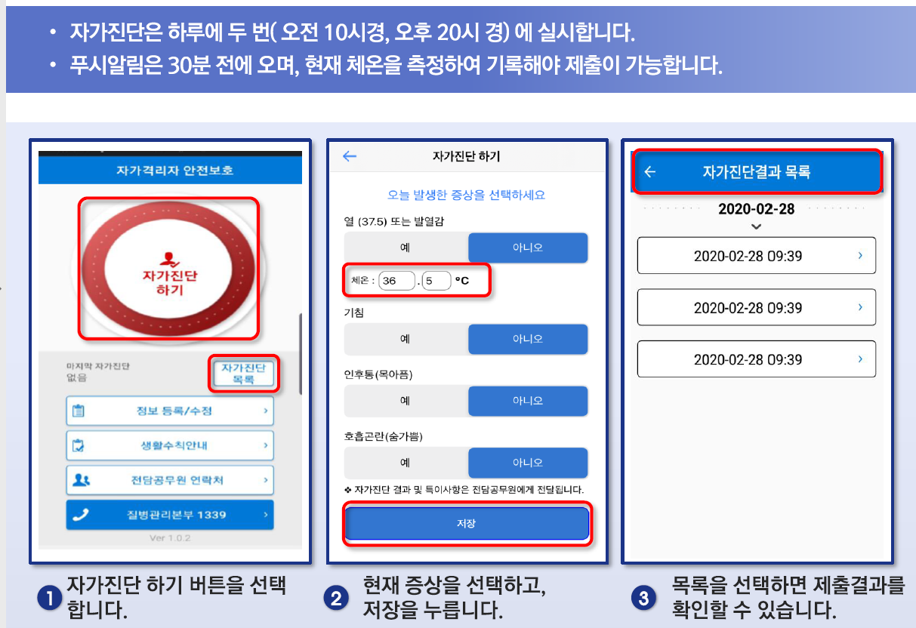
④
④
14 days of self-quarantine monitoring
Self-monitoring: twice a day (10am, 8pm)
Alarm will ring 30 minutes before each monitoring time, and you need to measure your temperature each time.

Slide 11
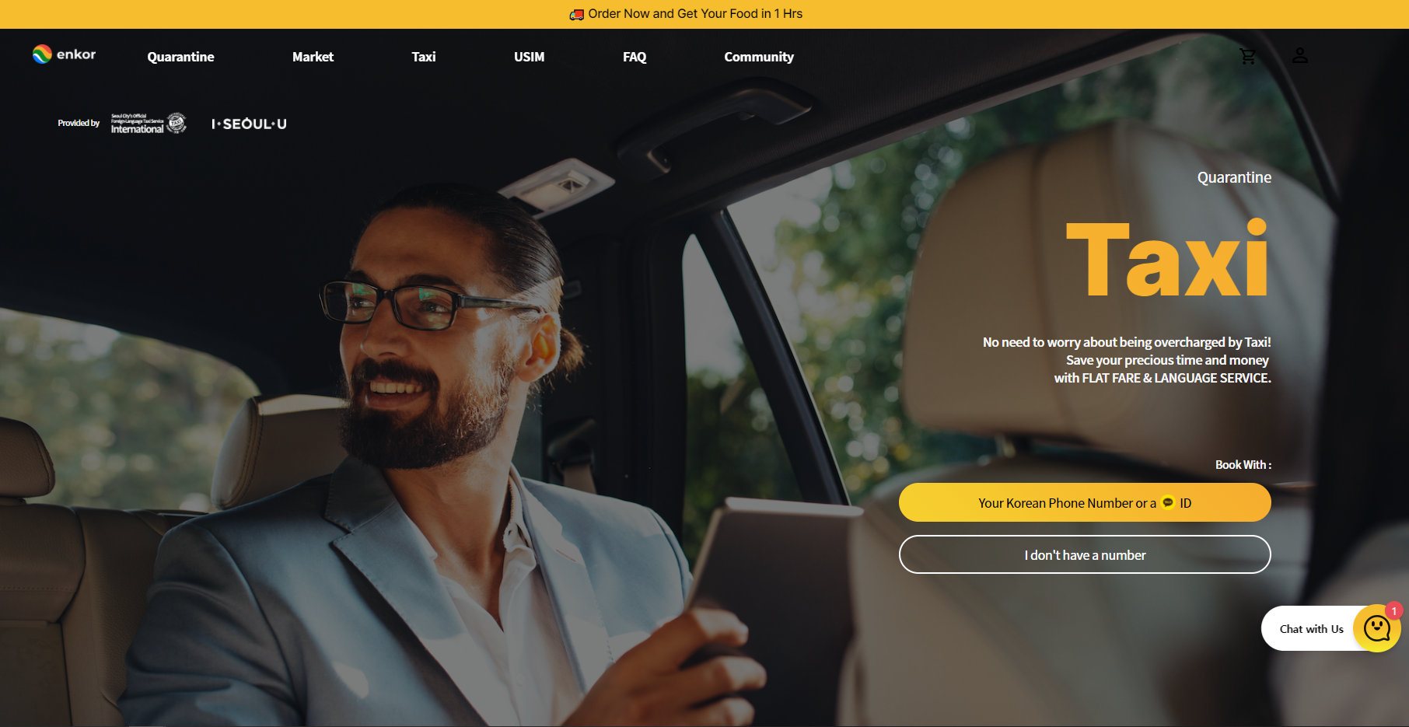
④
④
Support services during the quarantine
For the 3rd PCR test, make a booking for a cab (from your quarantine place to the local
health center) at https://www.enkor.kr/taxi
To order groceries and/or daily essentials,
- https://enkor.kr
- https://seoullife.shop

Slide 12
⑥
End of quarantine period
At noon on the 15th day from the date of your arrival in Korea
※You will receive an official notification to confirm that the mandatory quarantine has ended
Place all garbage collected during the 14 days quarantine period in the orange bag provided (including leftover food)
※ You may keep leftover food in the fridge during the quarantine period.
2. To prevent any leakage, use a white garbage bag provided to wrap the orange bag.
※ How to properly wrap your garbage: https://youtu.be/bkgylC3SuxE

Slide 13
Hope to see you soon!

